Slide 1
Building Enemies
A Guide on adding Enemies to a Unity Project
Presented By:
Dustin Goodpaster

Slide 2
What you'll need…
Unity 6
Visual Studios (preferred) or another IDE of your choice
Some sprites...
Let's get some sprites online for free
Here

Slide 3

Looking at the files
Here's the PNG file from the download. This is our sprite which lays out all the animations for our enemy

Slide 4
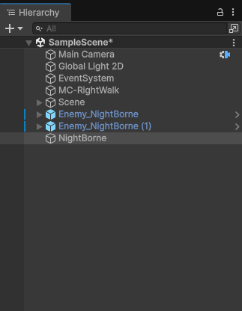
Building our GameObject
Goto Heirarchy, right click on the background and choose 'Create Empty'
This will give us an empty GameObject to start building into our enemy.
Let's rename this GameObject to NightBorne_Warrior.
*Ignore the other ones those are from previous builds, this one is new for this demonstration*

Slide 5
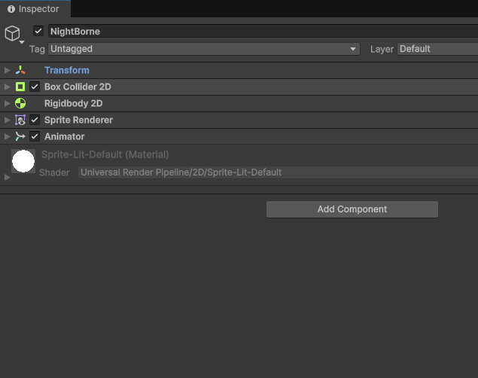
Let's add some properties to our Warrior!
Select the new GameObject
On the right hand side of the scree under the Inspector click Add Componet.
We need to add a Box Collider 2D, Rigidbody 2D, Sprite Renderer and Animator

Slide 6
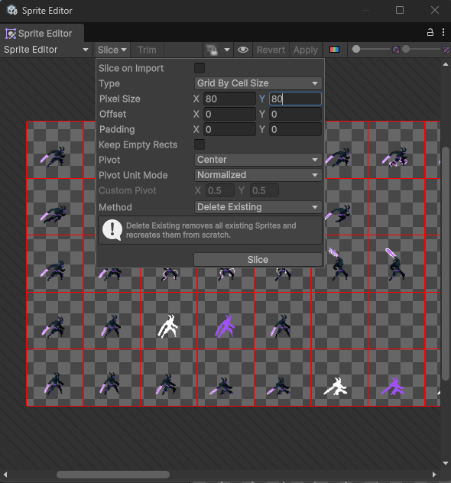
Now let's build some Animations to use
Navigate to the PNG file location in the Project explorer in Unity.
Mine was placed in Enemies>Nightborne
Select the PNG then click 'Open Sprite Editor' in the Inspector tab
For our example we'll 'Slice' our PNG in 80 x 80 Cells and click 'Slice' then click 'Apply'

Slide 7
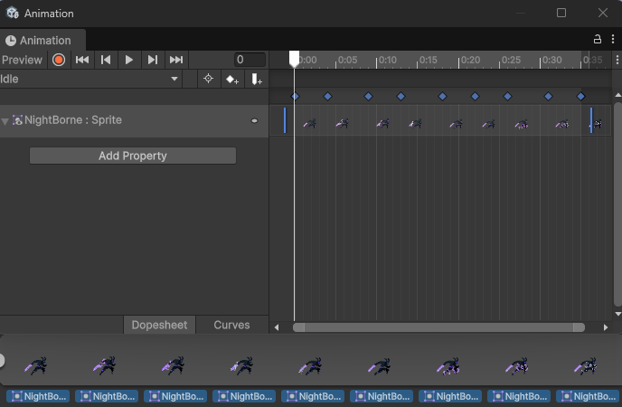
Creating Animation cont.
Open the Animation window, Ctrl + 6, click 'create new' then drag and drop the first 9 frames for our warrior.
You'll have to adjust the time scales etc. to get the animation speeds correct.
This will also create an animation controller for our enemy.

Slide 8
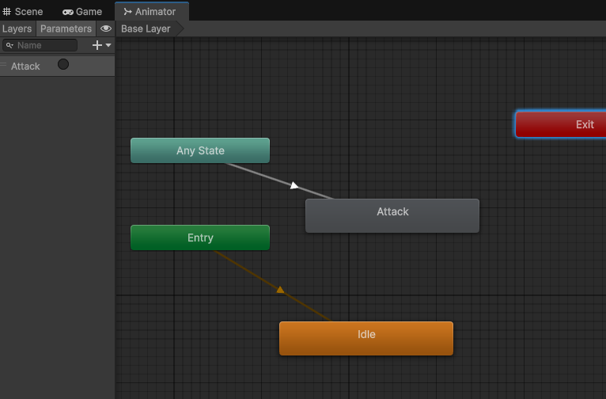
Setting up triggers
After creating the animations for things like Idle and Attack now we need a way to switch from one to the other.
This is done with the animation controller and triggers.
Under parameters click the plus sign and make a new 'Trigger' named Attack.
Add a transition from Any State.

Slide 9
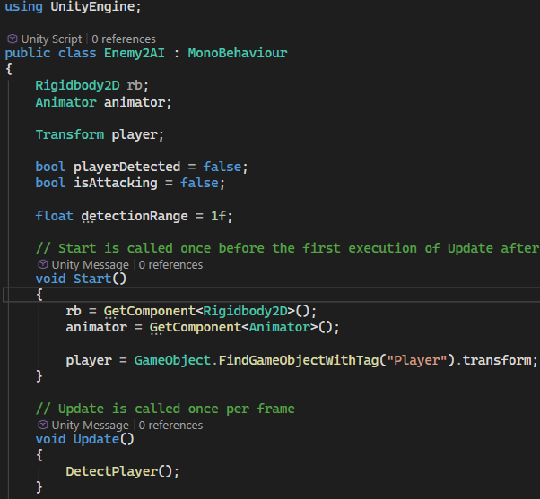
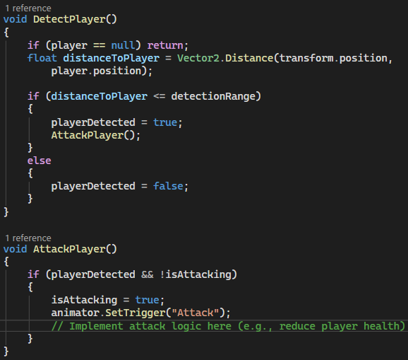
Let's write some code!

Slide 10
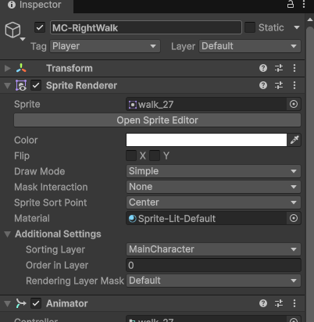
Add script to the enemy
Don't forget to make sure the main character has Tag set to Player
Now to make it all work we just need to click on the Nightborne_Warrior in heirarchy then under Inspector click 'Add Componet'
We're going to add our EnemyAI.cs to this enemy and now when the player comes close by our new animation will be triggered.

